Slide 1
HURRICANE SANDY

Slide 2
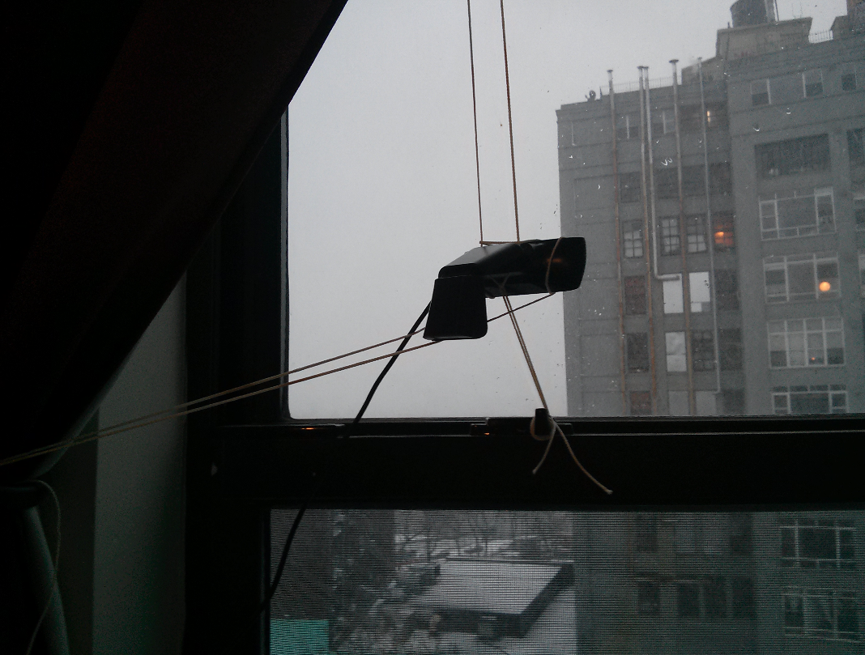
WEBCAM!

Slide 3
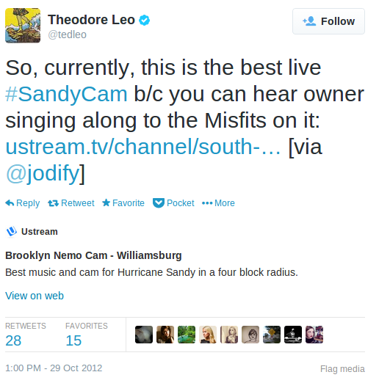
DAPS FROM TED LEO

Slide 4
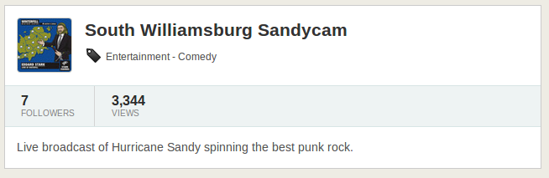
HOLY BISCUITS

Slide 5
THE PROBLEM

Slide 6
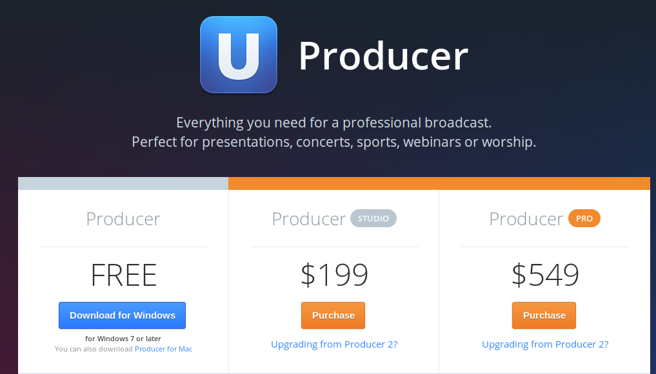
WINDOWS $$$

Slide 7

LINUX $0

Slide 8


THE MUSIC

Slide 9
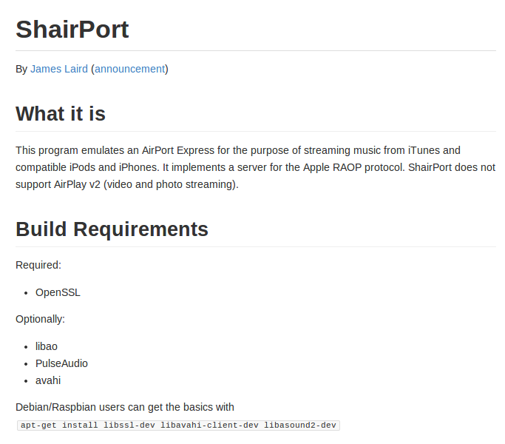
THE INPUT

Slide 10
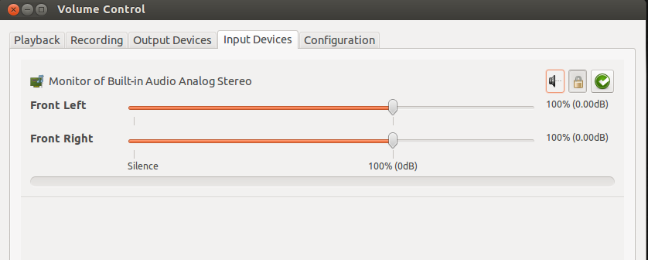
THE MIXER

Slide 11
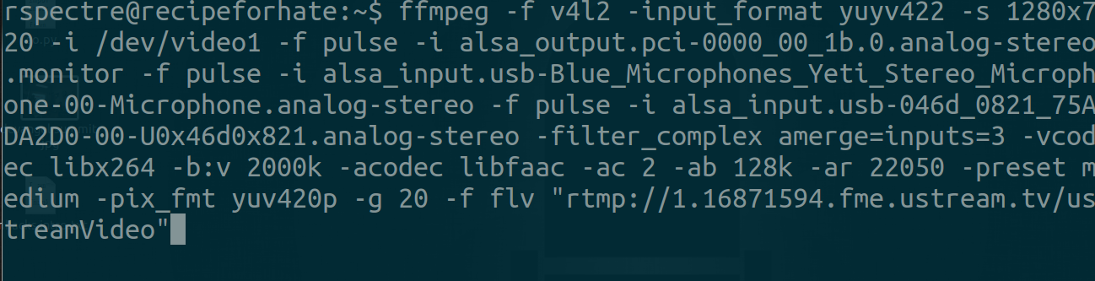
THE STREAMER

Slide 12


THE SERVICE

Slide 13

DO IT LIVE

Slide 14
THANK YOU
Github.com/RobSpectre/Talks
www.brooklynhacker.com
@dN0t – rob@twilio.com

